Slide 1
ELC1001 Critical Reading
Learn at your own pace

Slide 2
What will I learn?
How to connect a text to its context
How to identify the arguments a text is making
How to evaluate and respond to the arguments
How to critically read other modes of information

Slide 3
How will I learn it?
Videos grouped into 5 modules
Why read critically
Reading around the text
Identifying arguments
Evaluating arguments
Multimodal critical reading
Pause the video when you need to check your own learning
Complete a reflection survey at the end of the module

Slide 4

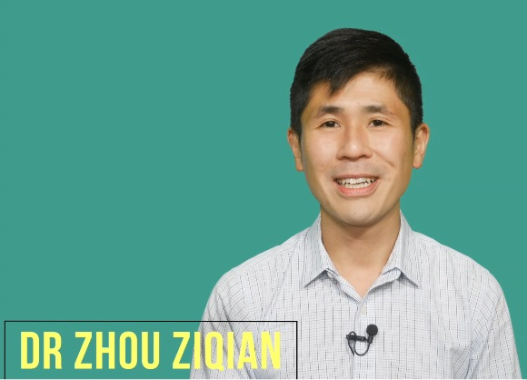

Who teaches it?
CELC instructors with backgrounds in language teaching, media studies, linguistics and philosophy

Slide 5
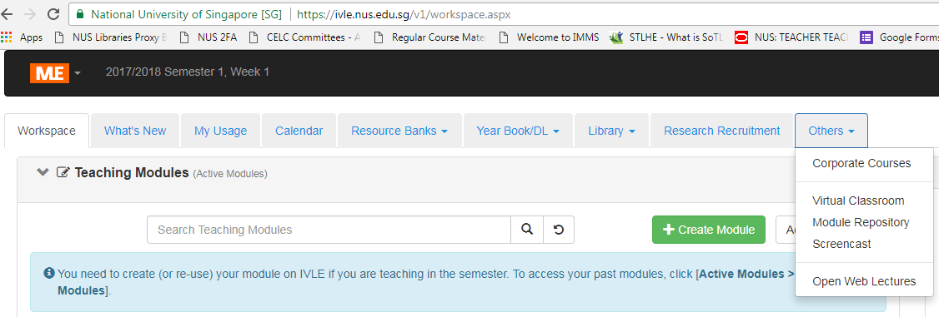
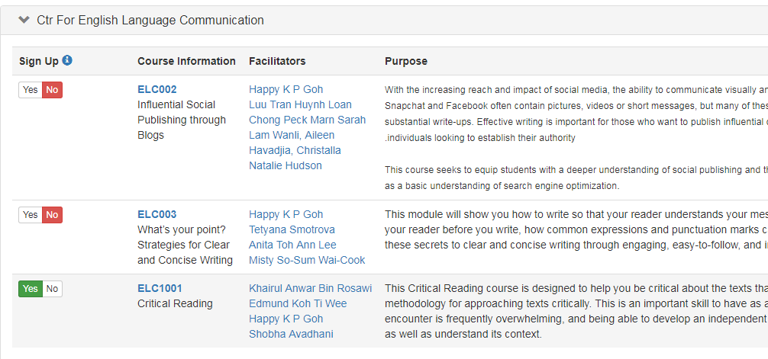
To sign up
Go to IVLE and click on the “Others” and select “Corporate Courses”
Scroll down until you see the course; click “Yes” next to the course code
You should now see the module in your IVLE home page.

